Slide 1


Predicting The fatal flaws The challenge of The unpredictable...
Jean Pariès
Dédale SAS France

Slide 2
PREDICTING THE FATAL FLAWS
DETECTING?
« The ‘Fatal Flaws’ are caused by increasing complexity and decreasing transparency in complex systems.»
What is “complexity”?
What are the main implications of complexity on safety management?

Slide 3
PREDICTING THE FATAL FLAWS
EVENTS?
« The ‘Fatal Flaws’ are caused by increasing complexity and decreasing transparency in complex systems.»
What is “complexity”?
What are the main implications of complexity on safety management?

Slide 4
PREDICTING THE FATAL FLAWS
(FUTURE!)
« The ‘Fatal Flaws’ are caused by increasing complexity and decreasing transparency in complex systems.»
What is “complexity”?
What are the main implications of complexity on safety management?

Slide 5
Complexity…

Slide 6
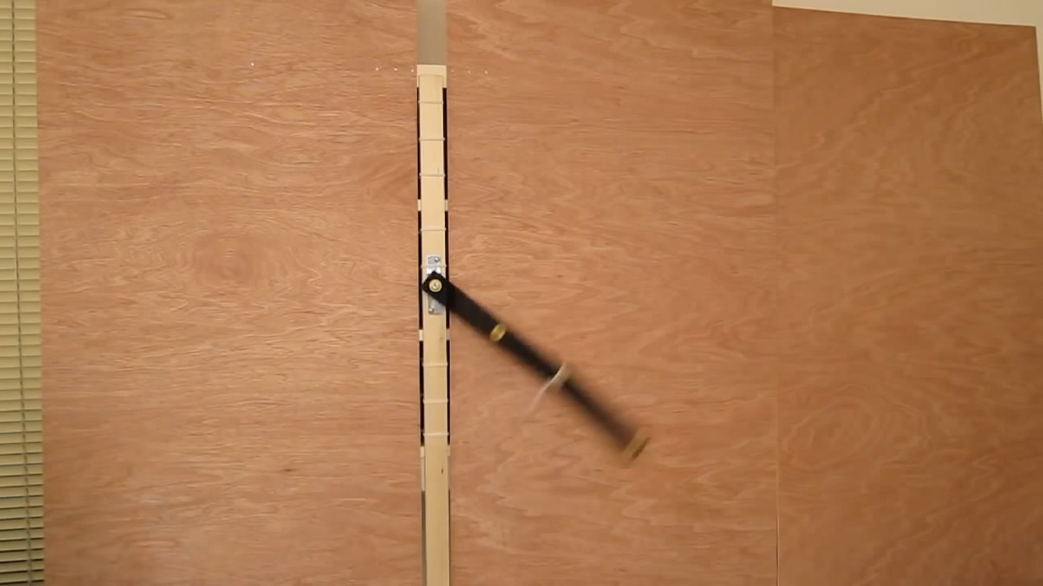
From simple to complex
Double pendulum
The interaction between two periodic (totally predictable) components makes a chaotic (unpredictable) system
A key feature of complex systems: their behavior results from components’ interactions, not from their (average) behavior
https://www.youtube.com/watch?v=AwT0k09w-jw

Slide 7

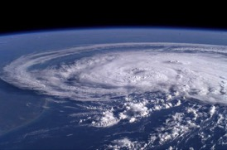
Large population systems
Simple (“more is similar”):
Interactions tend to annihilate individual differences (the noise)
Mean values determine large-scale system’s behavior
Brownian
movement
Complex (“more is different”):
Interactions tend to amplify individual differences
The amplified noise determines the system's large-scale behavior
Nearby states diverge from each other exponentially fast
Non linearity
Sensitivity to initial conditions
The system is then unpredictable
Emerging properties cannot be derived from analytical decomposition (they can only be observed, e.g. via simulation)

Slide 8
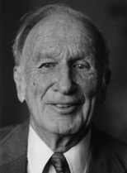
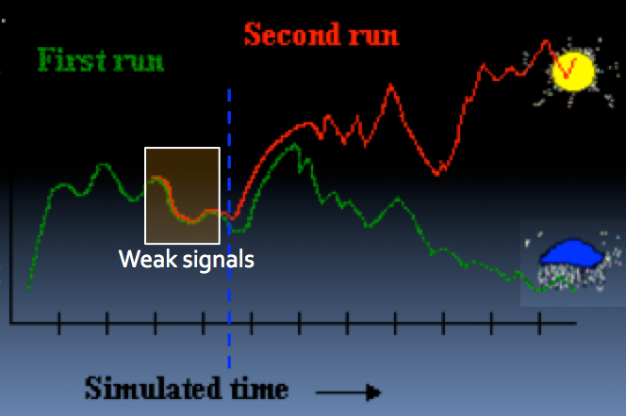
Chaos theory
Edward Lorentz
“When the present determines the future, but the approximate present does not approximately determine the future”
Past is obvious, future unpredictable

Slide 9
The rise and fall of ‘precursors’
About 15% of earthquakes are preceded by precursors (“Foreshocks”)
Usually identified AFTER, but not identifiable before
The difficulty is to discriminate meaningful signals from background noise
The key question: what is normal variation?
To be able to see, we need a model of what we are looking for!
Notes:
Some earthquakes are preceded by a few hours, days or weeks, by smaller tremors ("foreshocks").
13.2% of earthquakes of M> 6 between 1977 and 1996 had at least a "foreshock" of M> 5 on a 10-day interval before the main shock and within 75 km of the epicenter.
In the same time interval occur other phenomena:
non-seismic (radon emission, changes in the water level, electromagnetic emissions) related to the stresses to which the medium
or even non-physical: the abnormal behavior of animals
Limitations of the concept of precursor
Many earthquakes are preceded by "precursors", but:
Studies on the mechanisms of earthquakes themselves do not predict the short-term
The "foreshocks" are short-term precursors, but difficult to identify as such.
They are generally identified ex post and does not always occur.
Their qualifying post incites to exaggerate the cause-effect relationships
Related phenomena studies fail to link the phenomena observed with the earthquake models.
The physical processes that generate these phenomena are still poorly understood.
A major difficulty is to distinguish the expected signal from background noise: what is "normal"? (problem of the definition of the null hypothesis)

Slide 10
Current Safety Paradigm

Slide 11
The current vision of aviation safety
More reliability, automation, protections
More specifications, rules, procedures
More situations covered
More training for the expected
More compliance demanded
More standardization (interchangeable operators)
More “safety culture” (internalized constraints)
More reporting, more and more “data”
More control on people, less and less autonomy

Slide 12

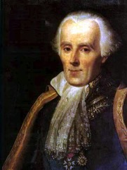
A “simple” world: linear, predictable, fully controllable
Deterministic and/or probabilistic anticipation of all potential situations
Predetermination of all the expected (safe) responses
Safety is warranted by the real world’s conformity to this designed-to-be-safe world.
Top-down command-and-control
Risk is seen as generated by deviations and variations
The modern ‘Holy Grail’: a world where nothing goes wrong, a perfect world (organizations, processes, teams, behaviors)
René Descartes
1596-1650)
Pierre-Simon Laplace
(1749-1827)

Slide 13
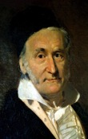
A linear vision of risk
Frequency
Carl-Friedrich Gauss
1777 – 1855
Normal distribution
The frequency of low severity events is perceived as a good assessment of disaster probability
ANTICIPATED
EVENTS
Focus is on that
SAFETY
STRATEGY
To prevent this
SURPRISES
UNEXAMPLED EVENTS
0
1
2
3
4
5
S. Deviation

Slide 14
The Henrich/Bird pyramid
Henrich, Fletcher & Bird (1974)
Insurance company
175’000 occupational accidents
297 companies
1 Fatal accident
10 accidents
30
quasi-accidents
600 deviations & unsafe situations

Slide 15
The pyramid myth
In a complex system, the frequency of rare & catastrophic events does not react in a simple way to changes in the frequency of day to day incidents
Fatal Accidents
Accidents
Incidents
Deviations

Slide 16
BST and Mercer ORC study (2011), along with seven global companies
OCCUPATIONAL SAFETY
Recordable Lost Time Injuries
Serious Injuries & Fatalities
TIME

Slide 17
From single to dual failure…
:
Single IFSD
(Incident)
Most frequent
causes
Dual IFSD
(Accident)
Fuel exhaustion
Fuel Contamination
Volcanic ashes
Bird strike
Flight Ops Error
FOD
Maintenance Error
Engine Reliability
100%
0%
0%
100%
Notes:
The probability of a second engine failure decreases considerably if the reasons for shutdown are independent.
The most frequent cause of a single IFSD is the least probable cause of a dual IFSD!
FOD 4%
Operational Error2%
Reliability 81%
Maintenance Error 13%
Dual:
Fuel exhaustion
Dual Maintenance Error
Fuel contamination
Dual F.O.D.
Correlated engine failures → Improbable
Reliability
Uncorrelated engine failures → Extremely improbable

Slide 18
From single to dual failure (In Flight Shut Down)…
:
Single IFSD
(Incident)
Most frequent
causes
Dual IFSD
(Accident)
The most frequent cause of a single IFSD is the least probable cause of a dual IFSD!
Fuel exhaustion
Fuel Contamination
Volcanic ashes
Bird strike
In a redundant system, independent causes are second order contributors
Flight Ops Error
FOD
Maintenance Error
Quality management is not safety management
Engine Reliability
100%
0%
0%
100%
Notes:
The probability of a second engine failure decreases considerably if the reasons for shutdown are independent.
The most frequent cause of a single IFSD is the least probable cause of a dual IFSD!
FOD 4%
Operational Error2%
Reliability 81%
Maintenance Error 13%
Dual:
Fuel exhaustion
Dual Maintenance Error
Fuel contamination
Dual F.O.D.
Correlated engine failures → Improbable
Reliability
Uncorrelated engine failures → Extremely improbable

Slide 19
MIT study (Barnett 2003)
Seeking correlation between incident rates and passenger death risk, across Major US jet airlines, 1990-1996
Significant negative correlation found!
“ Taken literally, the data suggest that a passenger would have reduced his airborne death risk over this period by preferring mishap-prone airlines”
“ Data analysis fails to support the conjecture that, the greater an airline’s involvement in mishaps, the greater its propensity to suffer the disasters that passengers fear ”.

Slide 20
From prediction to reality
 | Catastrophic accidents | Minimum target | Predicted value | Observed value | 90% Confidence interval
Space Shuttle | Loss of crew |  | 10⁻⁴ | 1,5.10⁻²
Nuclear PWR | Core melt /reactor/year | 10⁻⁵ | 7.10⁻⁶ | 1. 10^{–4} | [0.5 10^{–5}, 4.7 10^{–4} ]
Off-shore | Fatal accident/rig/year | [10^{–6}, 5.10^{–4}] | [10^{–5} , 10^{–4} ] | 1.7.10^{–3} | [ 0.5.10^{–3}, 4.4.10^{–3} ]
Aviation IATA, Jets, 2009/ 2013 | Hull loss/sector Fatal/sector Fatal/AC/Year | 10⁻⁶ ? 10⁻⁶ ? - | - - - | 2,26. 10⁻⁶ 0,5.10⁻⁶ 6,5.10⁻⁴
Most of the adaptation is “black matter” to the current safety paradigm
Notes:
[1.3.10–4 , 3.1.10–4] /(A320 x an) au niveau 90%
Les études probabilistes effectuées sur les centrales françaises évaluent à 3.10-9 la probabilité d’un accident grave (avec fusion du cœur et relâchement de produits radioactifs dans l’environnement) pour chaque réacteur, ce qui revient à un accident tous les trois millions d’années pour l’ensemble du parc installé en Europe, alors que la durée de vie d’un réacteur est d’environ 40 ans.

Slide 21
In other words…
Life is “complex”, even in normal situations (and even in aviation)
Changing, ambiguous, uncertain
Linear simplification (and the correlated top-down “command and control” vision) has done a good job but…
… it fails to acknowledge the limits to predictability inherent to a complex adaptive system
« Things that have never happened before, happen all the time » (S. Sagan- The Limits of Safety)

Slide 22
A paradigm shift?
Do we need to do better, and more intensively, what we already do?
… or is the current safety paradigm itself to be challenged?
We need a « shift from reducing uncertainty about the future to managing uncertainty as events unfold » (Kathleen Suttclife)

Slide 23


Two main strategies against complexity
Reducing complexity
Outmaneuvering complexity

Slide 24
Resilience…

Slide 25

Itnrnisic alibtiy of a sytesm to mantiain its struructal idetnity, its (mian) fetuares, and at lesat patrilaly its pefromrnace, in the prensece of disutrabnces, inlucding l, unsuual, or unteexpecd oens, gonig beoynd tshoe for wcihh the steysm had been dsigneed for, or thsoe to wihch it is adptead.
Intrinsic ability of a system to maintain its structural identity, its (main) features, and at least partially its performance, in the presence of disturbances, including large, unusual, or unexpected ones, going beyond those for which the system had been designed for, or those to which it is adapted.

Slide 26
Preparing to be unprepared
Enhanced capabilities to react and adapt
Far from, as well as near boundaries of safe operations envelope
Less predetermination, tighter coupling to reality
Shifting control from past to present,
And from the top to the bottom (front line) of organizations
Proactively developing a repertoire of generic strategies responding to generic threats
Identify basic states, “vital” actions
Developing sense-making capabilities

Slide 27

Resilience as adaptive capacity (D.Woods)
The more is a system "fit" (optimized for a given environment), the more sensitive it will be to disturbances.
An inescapable trade-off between optimality and fragility.
Optimum
Adaptation
Low
Adaptability
High
(Brittleness)
(Resilience)

Slide 28
The vicious circle of predetermination and vulnerability
More
Most capacities needed to cope with the unexpected are eroded in the continuous attempt to prepare for the expected.
Perceived vulnerability to the unexpected
Attempts to increase predictability
Surprises even more ‘surprising’
Simplification Anticipation Predetermination

Slide 29
Predicting fatal flaws…

Slide 30
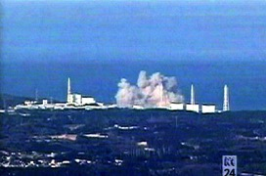

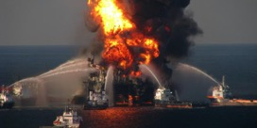
Contemporary fatal flaws
Demonstrated vulnerability to the unexpected, at all scales
Simple model for a complex world:
Denying complexity, missing adaptability needs, missing what produces success
Lack of margins of maneuver:
Productivity pressures, Lean functioning, Faster Better Cheaper
Lack of control:
Tight coupling, escalation, cascading effects, common mode failures, resonance
Lack of competence, lack of margins visibility
Lack of synergy:
Silos, fragmentation, working at cross purposes,
Local optimums, tragedy of commons
Lack of adaptability:
Hysteresis, stuck in obsolete schemes & behaviors
Inability to learn proactively
Fukushima
Air France 447
Deep Water Horizon

Slide 31
Future flaws?
Simple model for a complex world:
Denying complexity, missing adaptability needs, missing what produces success
Complexification of real world, increasing uncertainty
Oversimplification of models, linear thinking
Lack of margins of maneuver:
Productivity pressures, Lean functioning, Faster Better Cheaper
Increased optimization pressure
Lack of control:
Tight coupling, cascade effects, common mode failures, resonance
Lack of competence
Tighter coupling, interdependencies, networks of networks
Decreasing competence/complexity ratio in operations
Lack of synergy:
Silos, fragmentation, working at cross purposes,
Local optimums, tragedy of commons
Increasing fragmentation, local logics
Lack of adaptability:
Hysteresis, stuck in obsolete schemes & behaviors
Inability to learn proactively
Paralyzing impact of social, economical, political logics (e.g. financial, judicial constraints) on safety management

Slide 32
Conclusion
Current safety strategy seeks anticipation of all potential threats, eradication of variations, standardization, linearity, conformity.
Makes the system more and more efficient and reliable within its envelope of designed-for uncertainties, and more and more brittle outside it.
Safety strategies should rather recognize real world complexity (unpredictability) and develop outmaneuvering capacities (resilience features).

Slide 33


Thank you
jparies@dedale.net
www.resilience-engineering-association.org
Predicting The Fatal Flaws – RAeS- 26-27 November 2015

